Slide 1

Scrum Agile Method
Jennifer Cubillos

Slide 2




Introduction
In this PowerPoint presentation we will be going over the differences of the Waterfall method and the Scrum Agile method. This presentation will provide the pros and cons and help to assess which method is better for potential future projects.

Slide 3
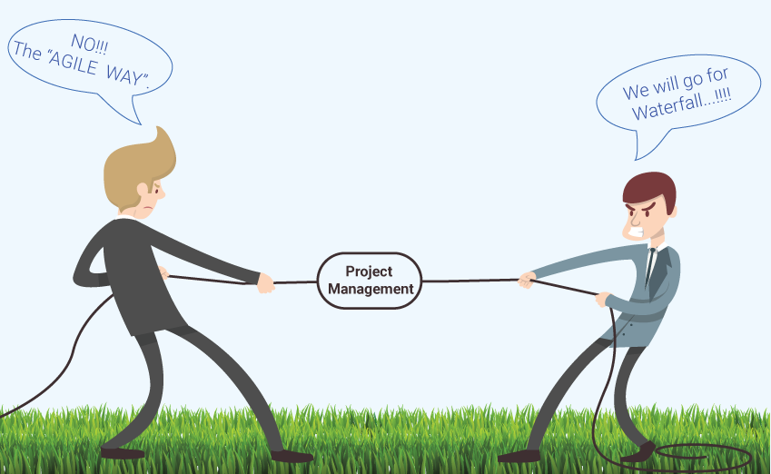
There has been much debate over which method is better to use for developing projects. Let’s go over the differences in each approach and you can decide for yourself.

Slide 4


What is the Waterfall Method?
The waterfall method is defined by its linear structured approach in developing a project. It consists of six phases that must be completed.

Slide 5
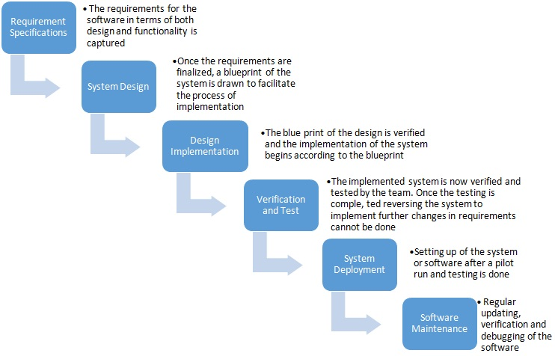
Waterfall Method Phases

Slide 6

Pros and Cons
Pros
Simple and easy to understand and use
Is useful with short term projects
Works well with projections that is clear and has direct plans
The structure provided is good for developers that may be inexperienced
Cons
All requirements need to be known upfront and can freeze a project
Inflexible
Each phase must be completed or the project is frozen and unable to move on to the next phase
Any issues cannot be worked on until the very last maintenance phase
Provides little opportunity to preview the software until it is fully completed

Slide 7

What is the Scrum Agile approach?
The agile approach is defined by its interactive approach. It does not require having all requirements from the client at the beginning, but rather focuses on the key product features of a project. The team can then delegate and work on the given tasks in phases which are known as sprints.

Slide 8

Various Roles on a Scrum Team
Product Owner
Ensures that the Product backlog is prioritized and well defined. They also make sure that it is always in alignment with the relevant business objectives. They are always in close contact with the client and makes sure to refine user stories for the team as needed to always have clear expectations for the team.
Scrum Master
As the Scrum master, I make sure to facilitate daily Scrum meetings, manage any issues that we may come across during a project, make sure to prioritize communication with my team, and always encourage a positive and supportive environment.
Development Team
The development team takes the feedback and instructions that they receive from the user stories and from the Scrum master and begins to develop the software based on the requirements that were specified by the client. They also test the software to make sure it is functioning properly.
Stakeholders
Individuals or groups that have a vested interest in the success of the project. This can include customers, end users, managers, or anyone else effected by the product. They help by providing feedback to the Product Owner.

Slide 9
Various Phases
Phases | Description
Gathering Requirements | The Product owner works with client and stakeholders to gather key requirements for the project. This allows the product owner to prioritize each task and create a product backlog for the team. Most requirements are received as user stories or short descriptions.
Planning | The Product Owner, Scrum Master, and Development Team work together to plan a sprint. They review the product backlog and decide which user stories or requirements that they will include in the sprint and estimate the time it will take for the team to complete the tasks.
Sprint | The Sprint is the core essential of the Agile model. During a sprint, the development team focuses on the tasks that were assigned to them. They work on developing an increment of the software they are trying to create, test the software in order to ensure there are no errors or issues.
Review | After a sprint is completed, the development team then meet with the stakeholders in order to present the software they have completed. Their goal is to receive feedback to have a better understanding of what is working well and what may need improvement.
Retrospective | The Scrum Master and development meet to discuss what went well and what didn’t and what may need to be improved for the next sprint.

Slide 10

Pros and Cons
Pros
Appropriate for projects in which only key feature requirements can be provided in the beginning of a project.
Frequent interaction with stakeholders
Learning and growth happens within the projects which leads to enhanced customer satisfaction
Project development is adaptable and flexible
Leads to lower costs because there is less risk or client and product misalignment
Cons
Companies may be resistant to embracing change
Trouble providing accurate estimation of completion timeframe
Requires software developers who are experienced

Slide 11
How might this project look different with the waterfall method?
In the Gathering Requirements phase, the process is much more in depth and comprehensive. It takes a lot longer because it cannot just have key features provided, but all requirements necessary for the project as a whole
In the Design Phase, the team creates a detailed design for the project. This includes specifications for each module and each component of the whole project. They then create a plan for how they will proceed forward.
In the Implementation phase, the development team creates the software from the plan they had created in the previous phase. They must develop the entire software to completion.
In the testing phase, the team tests the software that has been completed. Now they can test for any defects or tackle any issues they encounter.

Slide 12
What factors to consider when choosing between the Waterfall or Agile method
The choice between Waterfall or Agile depends on certain factors:
The nature of the project
The complexity of the project requirements
The budget limits
Time allotted for a project
Team’s experience and capability

Slide 13
References
Kavlakoglu, Eda. (2020, Nov 4). Agile vs Waterfall. IBM. https://www.ibm.com/cloud/blog/agile-vs-waterfall
Hoory, Leeron. (2022, Mar 5). What Is Waterfall Methodology? Here’s How It Can Help Your Project Management Strategy. Forbes Advisor. https://www.forbes.com/advisor/business/what-is-waterfall-methodology/
Stanke, Bob.(2022, May 2). Agile Methodology: Pros and Cons. Bob Stanke Media. https://www.bobstanke.com/blog/agile-methodology-pros-and-cons#:~:text=Agile%20methodology%20offers%20numerous%20benefits%2C%20such%20as%20flexibility%2C,team%20commitment%2C%20and%20the%20potential%20for%20scope%20creep.
University of Minnesota. (2022, Feb 11). Agile Methodology: Advantages and Disadvantages. College of Continuing & Professional Studies. https://ccaps.umn.edu/story/agile-methodology-advantages-and-disadvantages

